Slide 1
ENPOWERING ACADEMIC LEARNING
By
ANUBHAV SHARMA
(CUHP21MCA08)
ABHISHEK KUMAR
(CUHP21MCA03)

Slide 2
Table of Contents
Introduction
Proposed System
Flow Chart
System requirements
Snapshot of the Project
Conclusion

Slide 3
Introduction
In this presentation, we present Study Point a student management system that provides question papers and study material to students. To make educational resources more available to students by providing study materials and previous year question paper.

Slide 4
Proposed System
Our project is made to provide study material or previous year question papers for students.
Benefits-
1.This website enhance the learning experience
of students.
2. StudyPoint offers a range of functionalities, providing students with high-quality Study resources
3. Students may quickly download test questions and access suggested notes, saving time and effort.

Slide 5
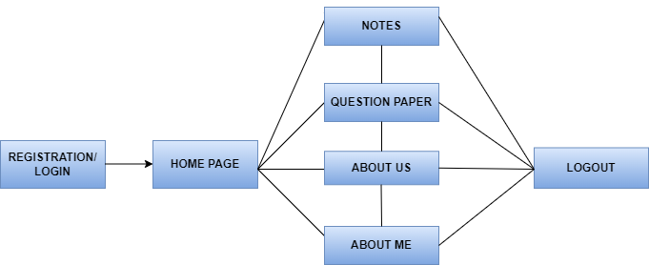
Flow Chart
Empowering Academic Learning

Slide 6
System Requirements
Operating System - Windows 10
Front End - HTML, CSS, Bootstrap
Backend - PHP
Database - MySQL
Web Server - Apache

Slide 7
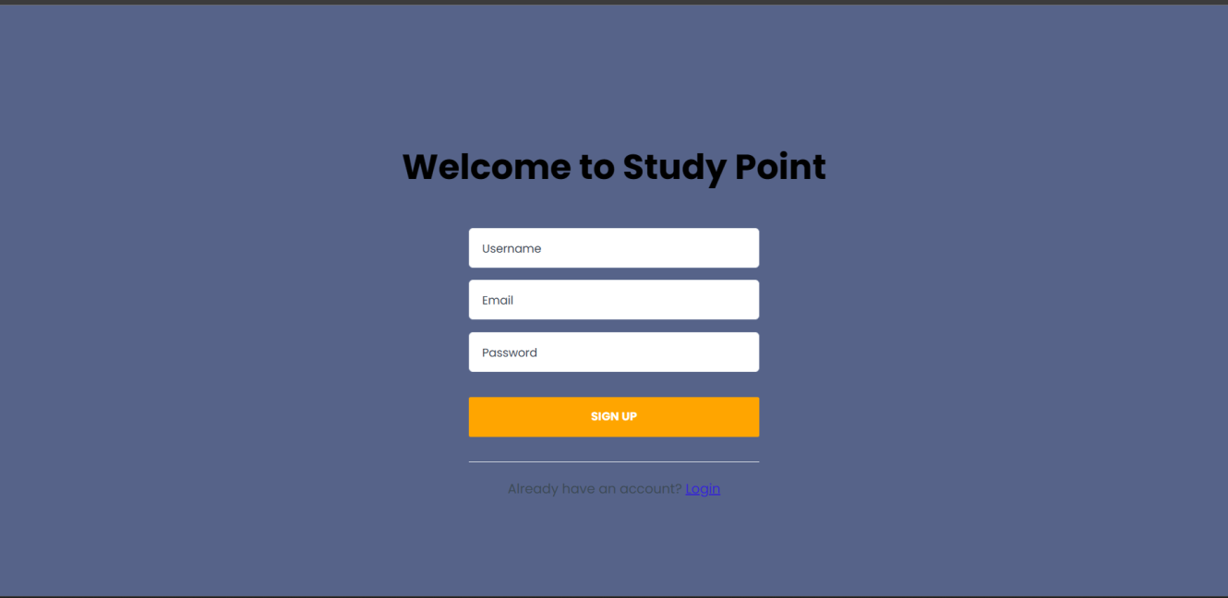
Snapshot of Project
Registration Page:
• We have to enter the Name, email-id and password for registration
• After the registration is complete, the details of the user will be saved to the database.

Slide 8
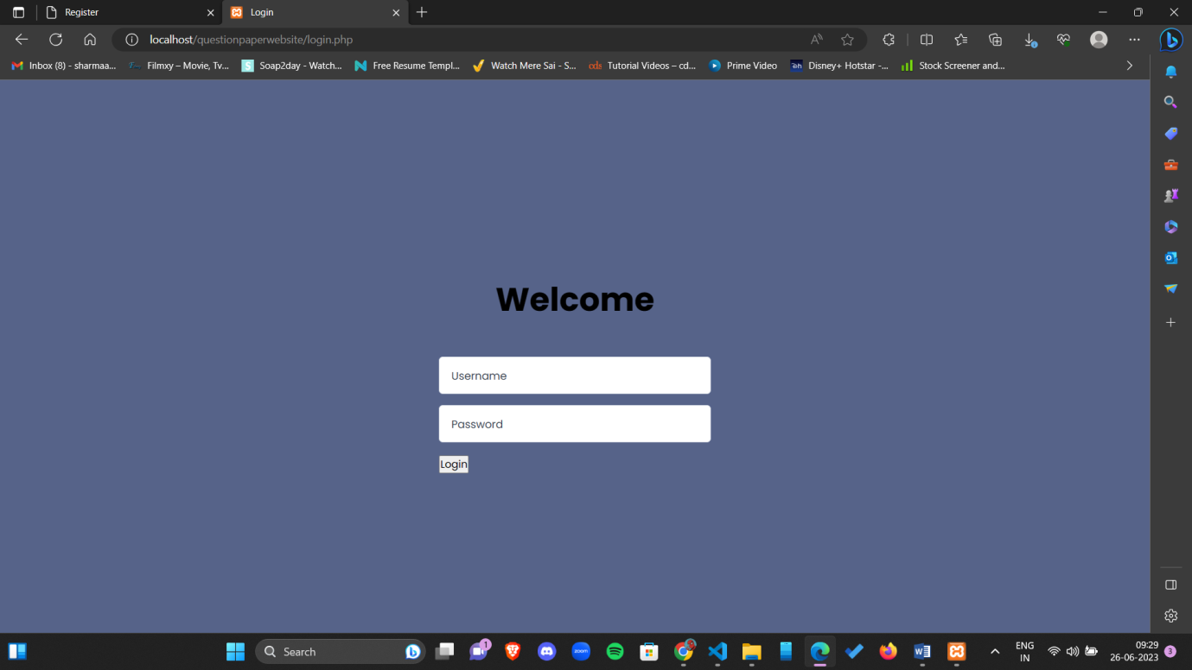
Login Page
• The login page enables the user to access the home page.
• Users will be asked to enter his/her credentials which are user email and password.

Slide 9
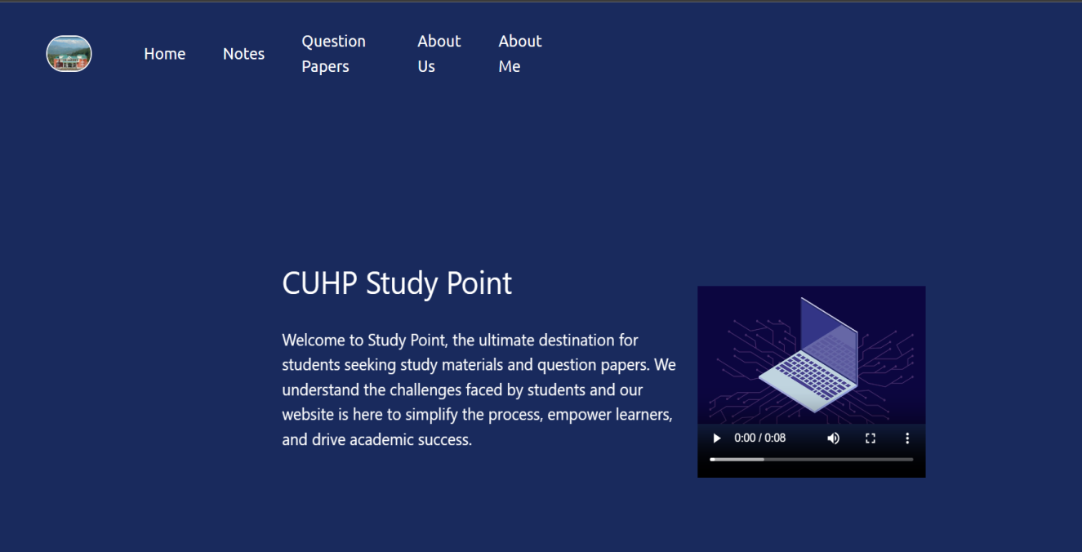
Home Page
• This page is the base/index page of StudyPoint.
• Whenever any user visits our site he/she will get this page.
• This page consists of information about StudyPoint.

Slide 10
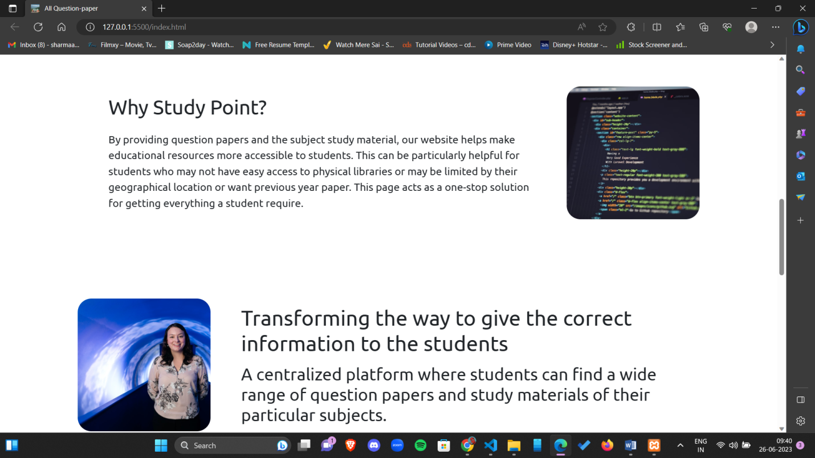
Home Page

Slide 11
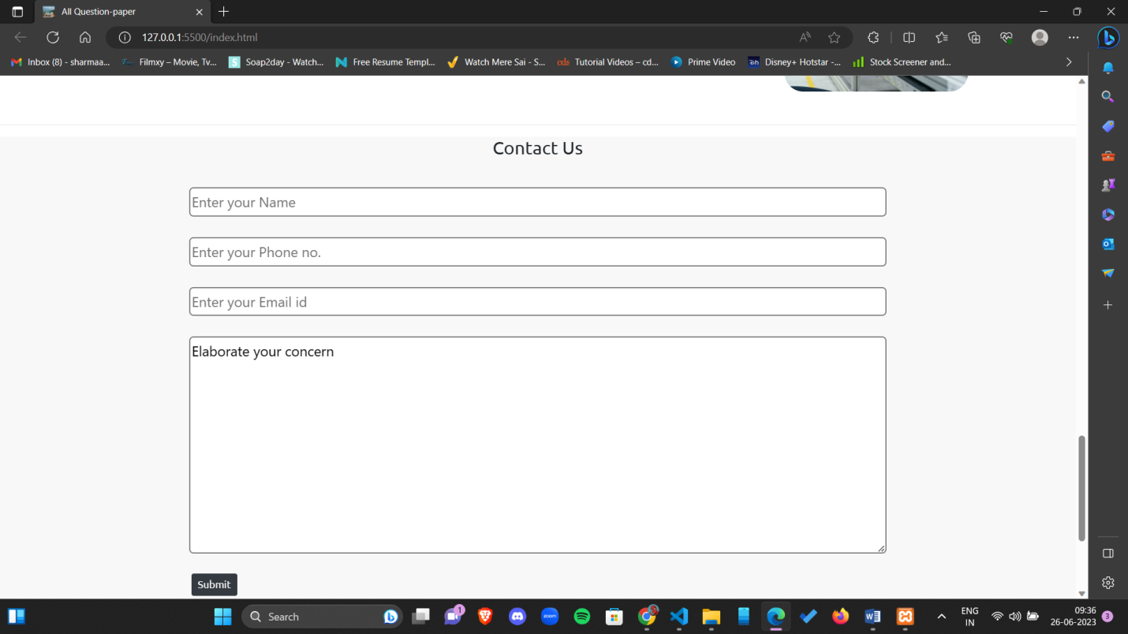
Contact Form

Slide 12
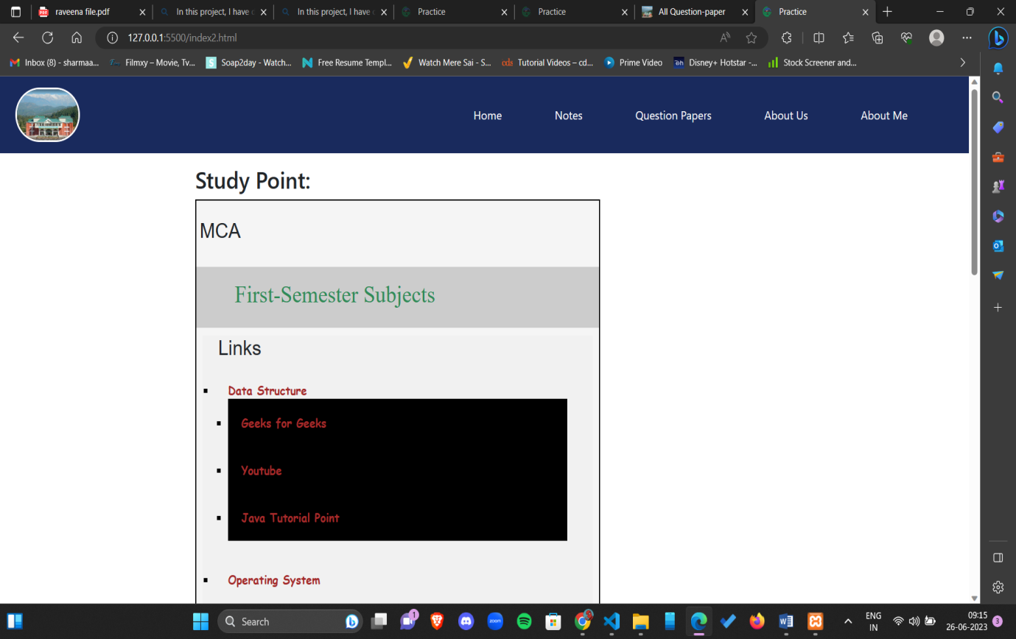
Study Material
• This page provides the study material to the users.
• When the users access this page, they have to click on their department and then on the subject.

Slide 13
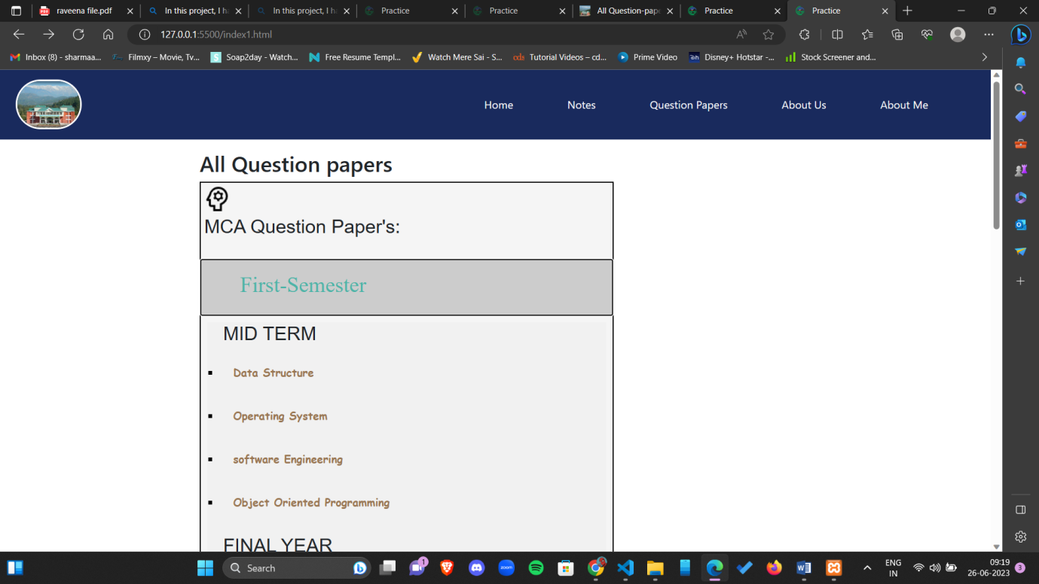
Question Paper
• This page provides the users with the question papers.
• A list of subjects will appear after clicking on the semester.

Slide 14
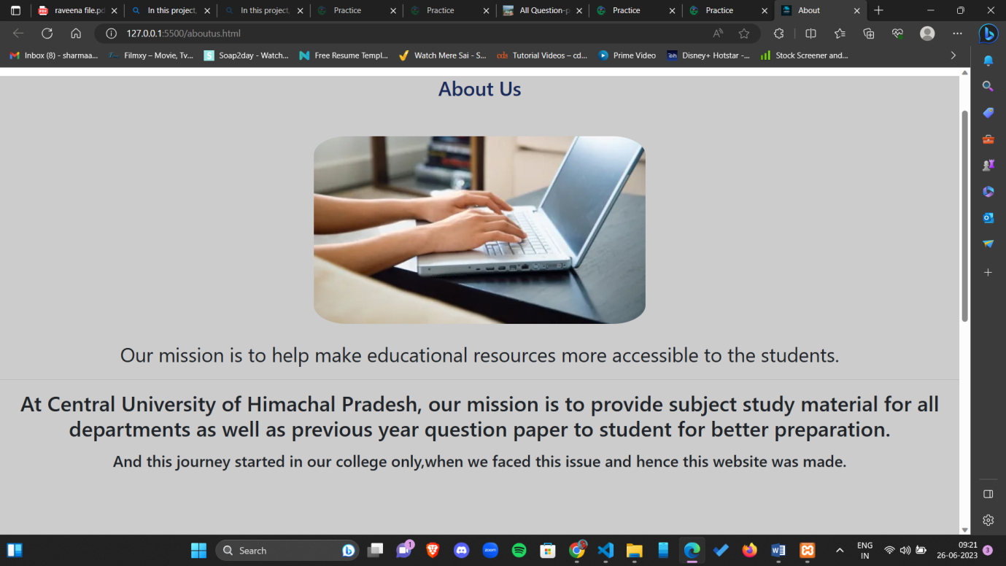
About Us
• This page will give some details of the developers.
• Their motivation and the reason of the development of this project.

Slide 15
Conclusion
This web application helps in providing study material and previous year question papers to make educational resources more available to students. This website aims to enhance the learning experience and academic performance of users. The website has successfully achieved its objectives of providing a user-friendly platform students and administrators. StudyPoint offers a range of functionalities, providing students with high-quality Study resources and question papers enabling students to enhance their knowledge and skills.

